Slide 1
PRDA-04
Job Market Analysis
Exploratory Data Analysis of U.S. Data Science Job Postings
742 job postings • 42 features • U.S. nationwide
Prepared by S Suhaiyla Sulthana

Slide 2
Key Findings at a Glance
Headline numbers from the analysis of 742 job postings
20.5%
42.2%
52.8%
+22%
of all postings are in California — the single largest job market
of postings are for the title “Data Scientist”, the most common role
of postings require Python — the most in-demand skill overall
higher average salary for PhD-credited roles vs. no degree requirement
PRDA-04 | Job Market Analysis
2

Slide 3




Dataset & Methodology
Source
742 job postings pulled from the project MySQL database (project_job_market_analysis.Market) via SQLAlchemy / pymysql.
Features
42 columns spanning job identity, compensation, company profile, location, 16 binary skill flags, simplified job title, seniority, and degree requirement.
Cleaning
Sentinel value -1 (“missing”) handled per-column: median-imputed for Rating, recoded to “Not Disclosed” for categorical fields, left as NaN for Age/Founded.
Tools
Python (pandas, seaborn, matplotlib) for the EDA in this report; the same findings were rebuilt as an interactive four-page Power BI dashboard, shown later in this deck.
PRDA-04 | Job Market Analysis
3

Slide 4
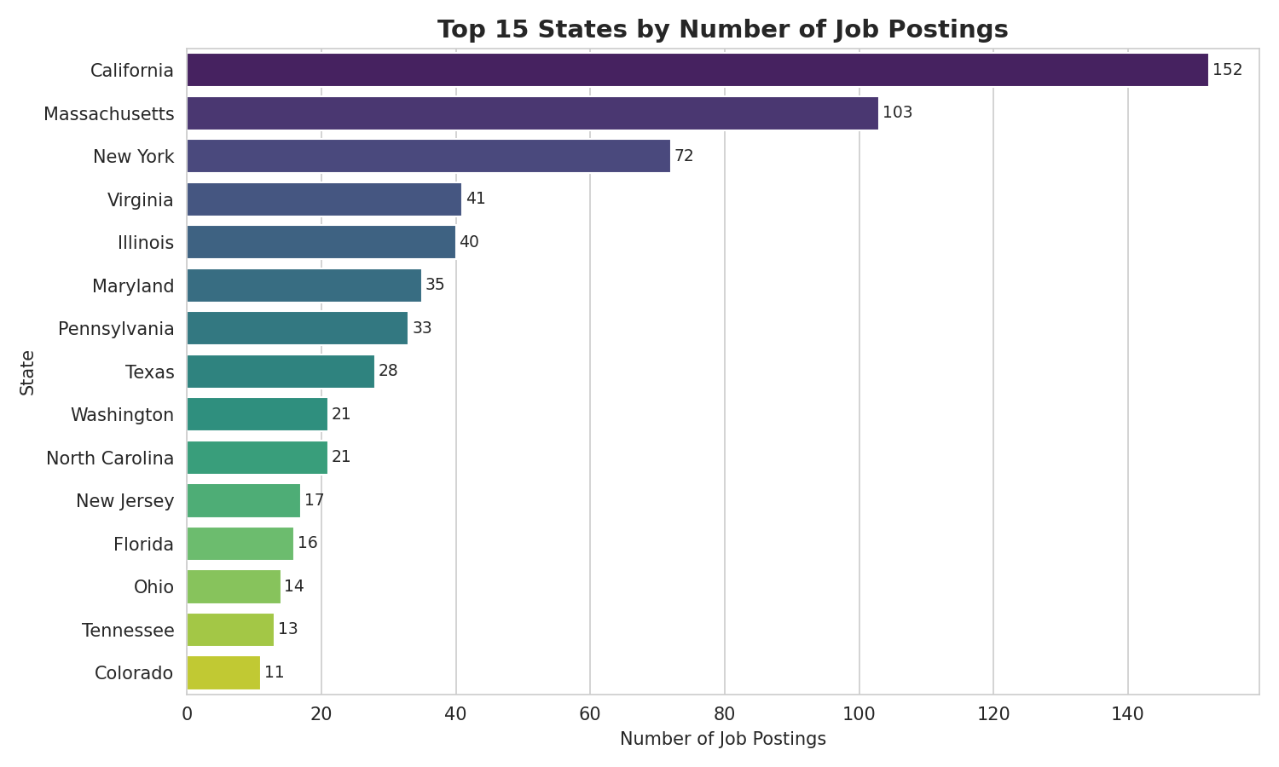
Where Are the Jobs? — Top States
California, Massachusetts, New York & Virginia drive ~50% of postings
California: 152 postings (20.5%) — by far the largest market
Top 4 states = ~50% of all postings nationwide
Massachusetts (103) ranks 2nd, ahead of New York (72)
Driven by tech (CA), biotech/pharma (MA) & federal/defense (VA)
PRDA-04 | Job Market Analysis
4

Slide 5
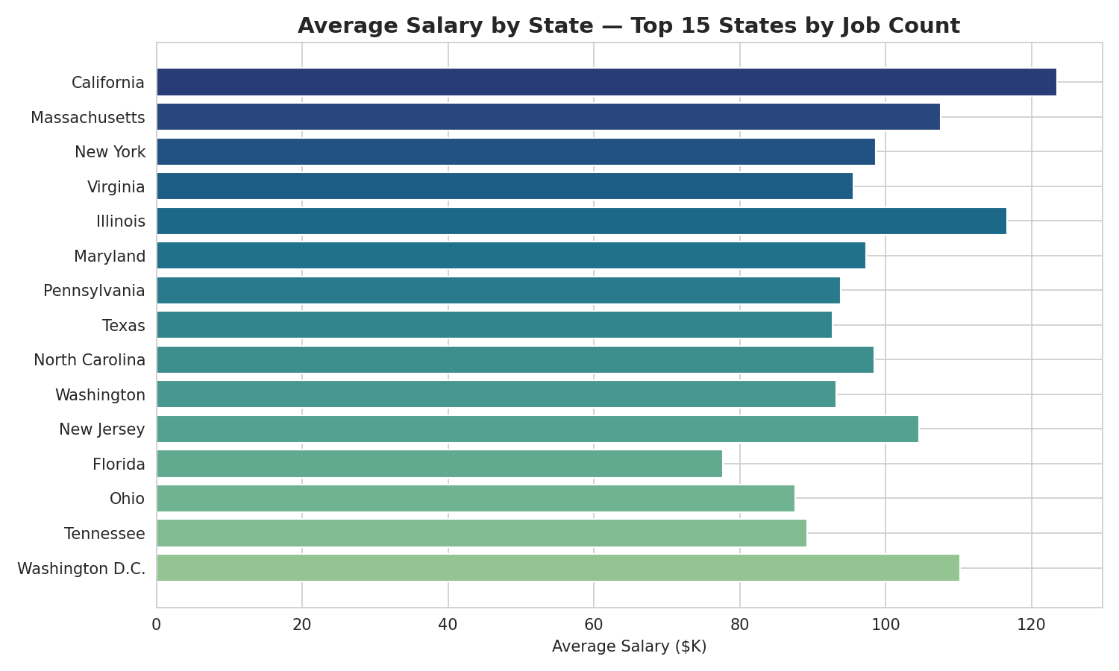
Where Does It Pay Best? — Salary by State
California leads on average salary; Illinois and D.C. follow closely
California: highest avg. salary at $123.5K
Illinois: $116.7K — punches above its job-count rank
Washington D.C.: $110.2K, despite fewer postings
Florida & Ohio trail the top states on pay
PRDA-04 | Job Market Analysis
5

Slide 6
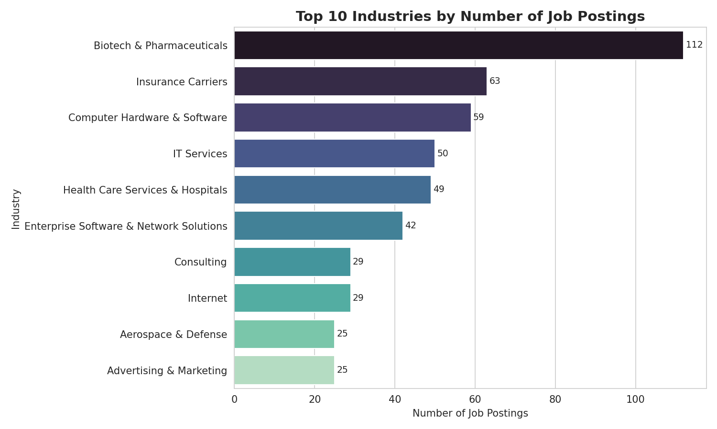
Top Hiring Industries
Biotech & Pharma leads — ahead of traditional IT Services
Biotech & Pharmaceuticals: 112 postings (15.1%) — #1
Insurance Carriers (63) and Computer H/W & Software (59) follow
IT Services ranks only 4th (50 postings)
Top 10 industries = 65% of all postings
PRDA-04 | Job Market Analysis
6

Slide 7
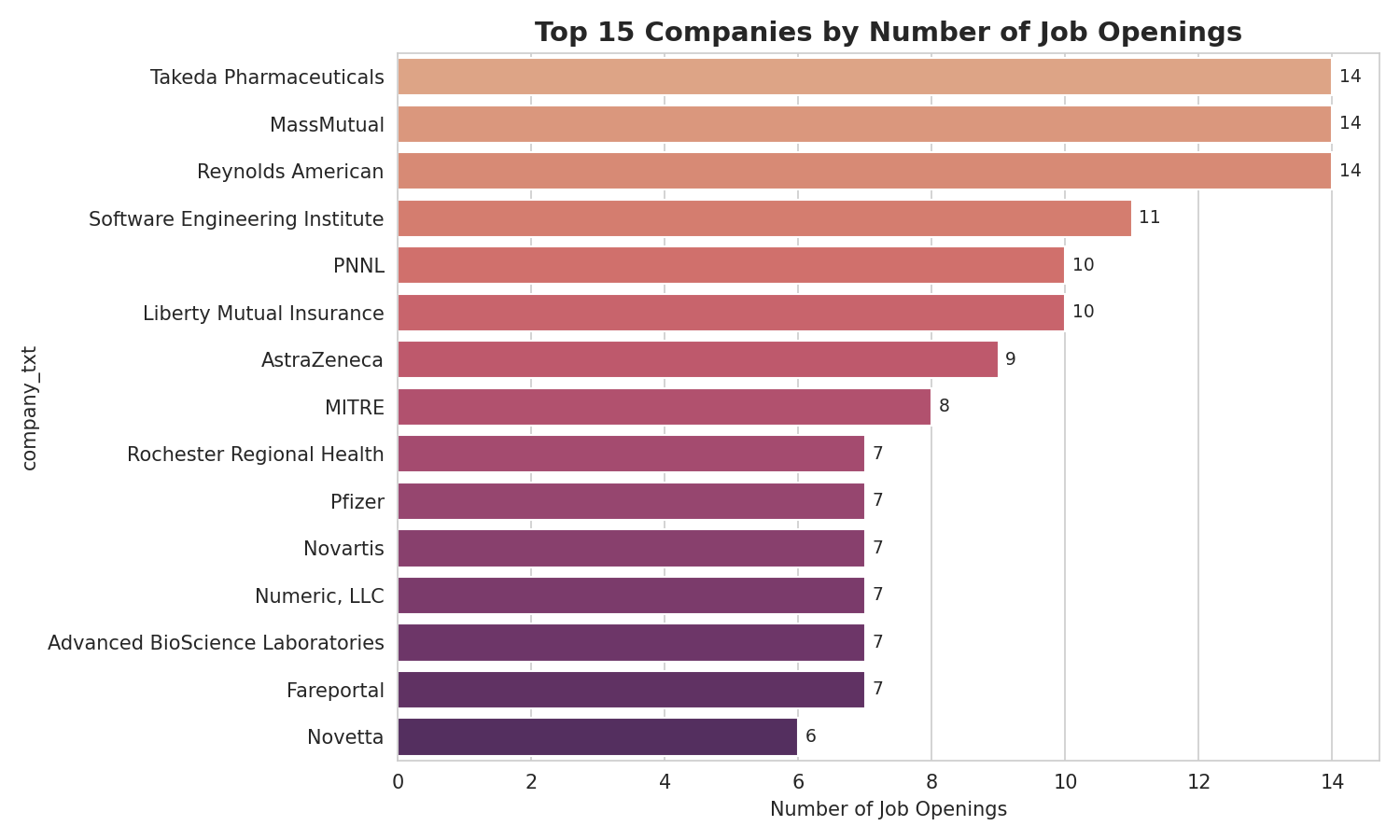
Who's Hiring? — Top Companies
343 distinct employers — hiring is broad, not concentrated
Takeda Pharmaceuticals, MassMutual & Reynolds American tie at 14 postings each
343 distinct companies in total — most post only 1-2 roles
55% of postings come from privately-held companies, 26% from public companies
PRDA-04 | Job Market Analysis
7

Slide 8
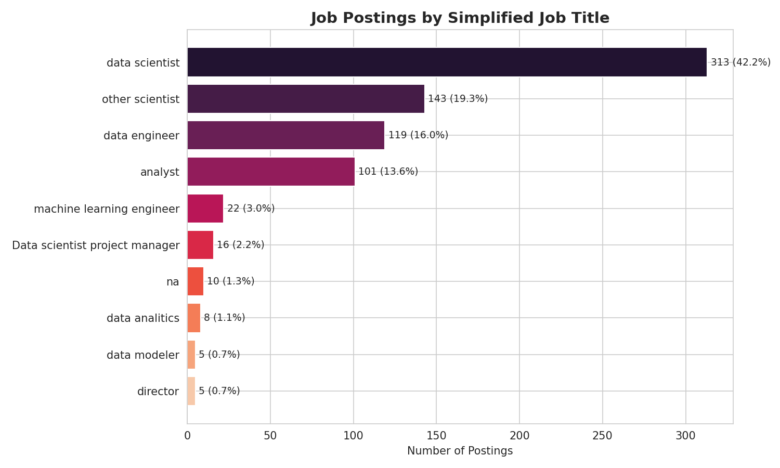
Job Titles: Volume vs. Pay
Data Scientist dominates volume — but Director & ML Engineer pay more
Average Salary by Job Title
Job Title | Avg Salary
Director | $130.8K
ML Engineer | $126.4K
Data Scientist | $118.3K
Data Engineer | $105.4K
Other Scientist | $88.1K
Analyst | $66.1K
Director and ML Engineer roles are rare (5 and 22 postings) but command the highest pay per posting.
PRDA-04 | Job Market Analysis
8

Slide 9
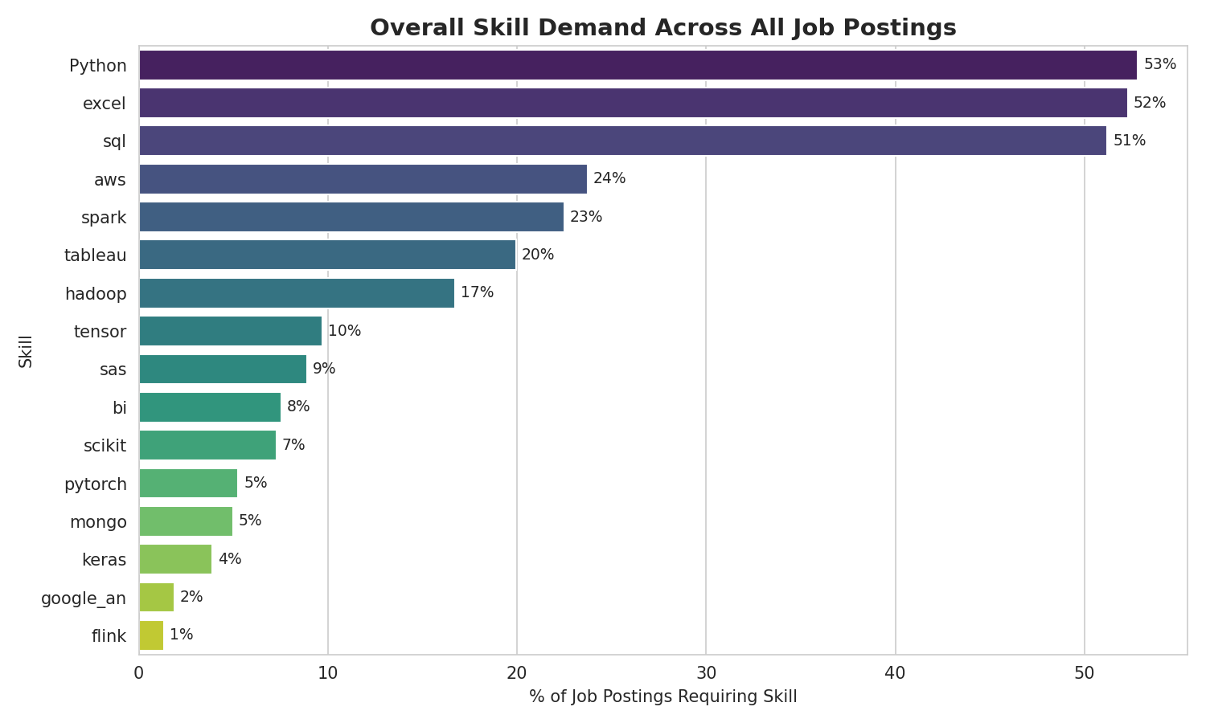
Skills in Demand
Python, Excel & SQL form the baseline toolkit for every data role
Python (53%), Excel (52%), SQL (51%) — required in roughly half of all postings
AWS (24%) & Spark (23%) — the cloud/big-data second tier
Tableau (20%) leads BI/visualization tools
Deep-learning frameworks (Keras, PyTorch) remain niche (<6%)
PRDA-04 | Job Market Analysis
9

Slide 10
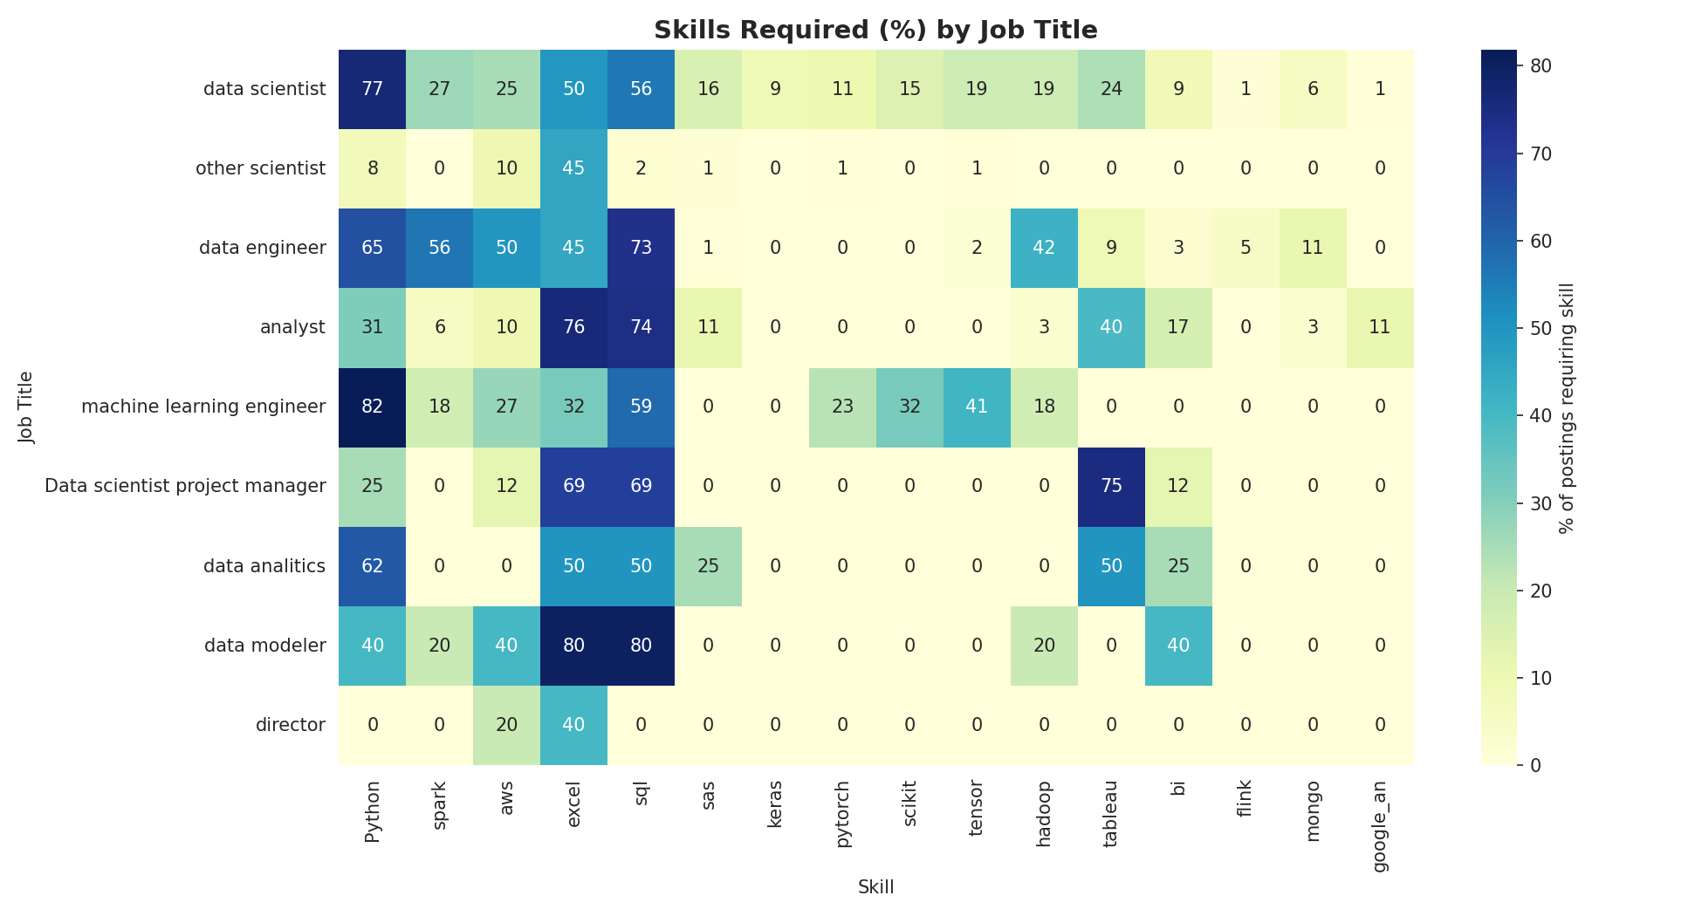
Skills Required, by Job Title
Each title has a distinct skill fingerprint
PRDA-04 | Job Market Analysis
10

Slide 11
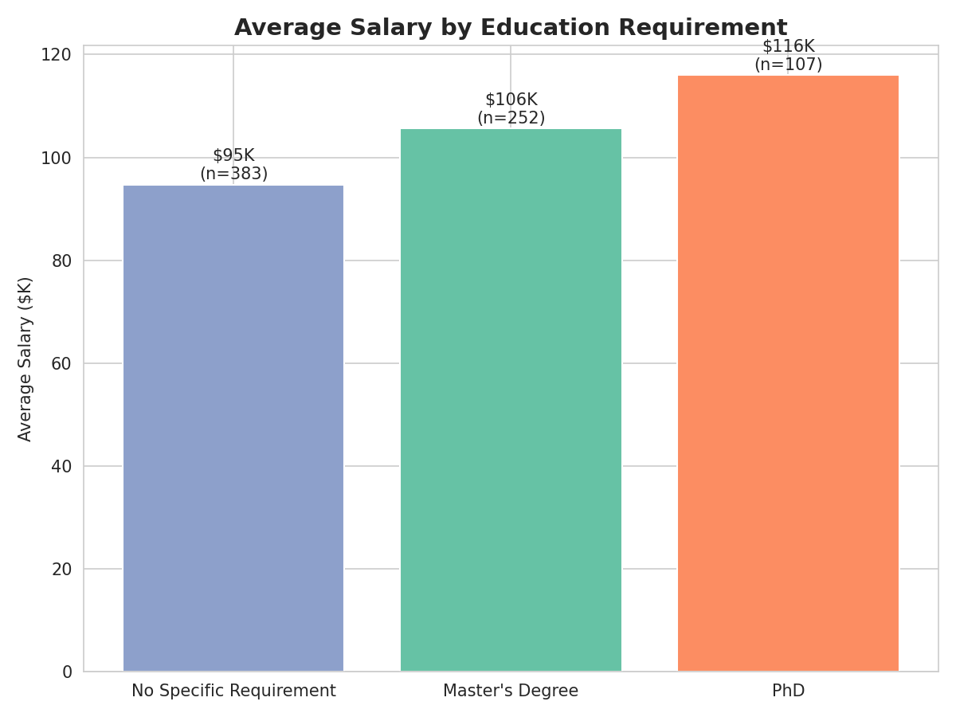
Education Pays Off
PhD-credited postings pay 22% more than postings with no degree requirement
No Requirement: $94.7K avg. (51.6% of postings)
Master's Degree: $105.6K avg. (+12%) (34.0% of postings)
PhD: $116.0K avg. (+22% vs. none) (14.4% of postings)
Pattern holds across the full salary distribution, not just averages
PRDA-04 | Job Market Analysis
11

Slide 12
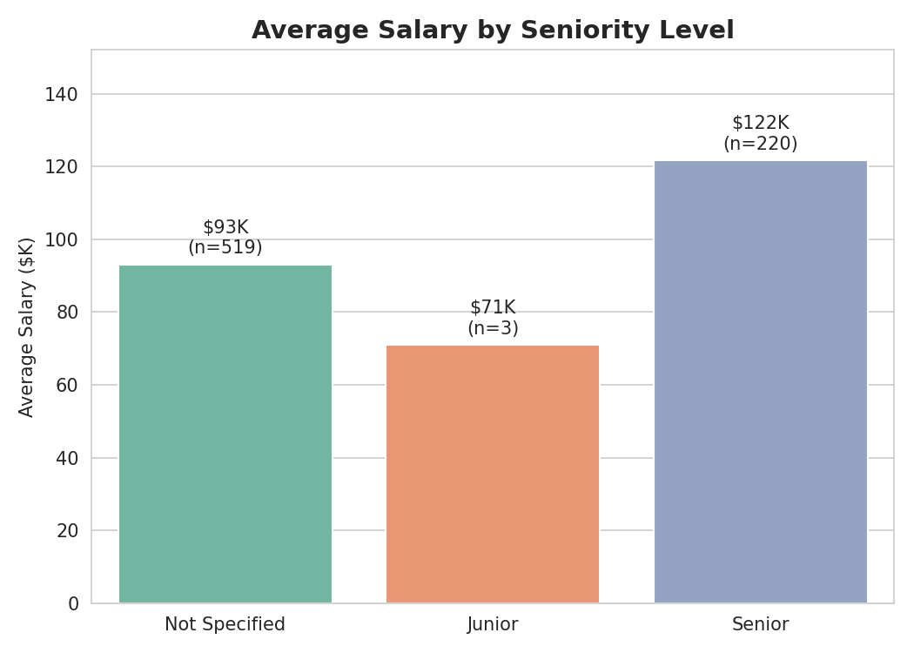
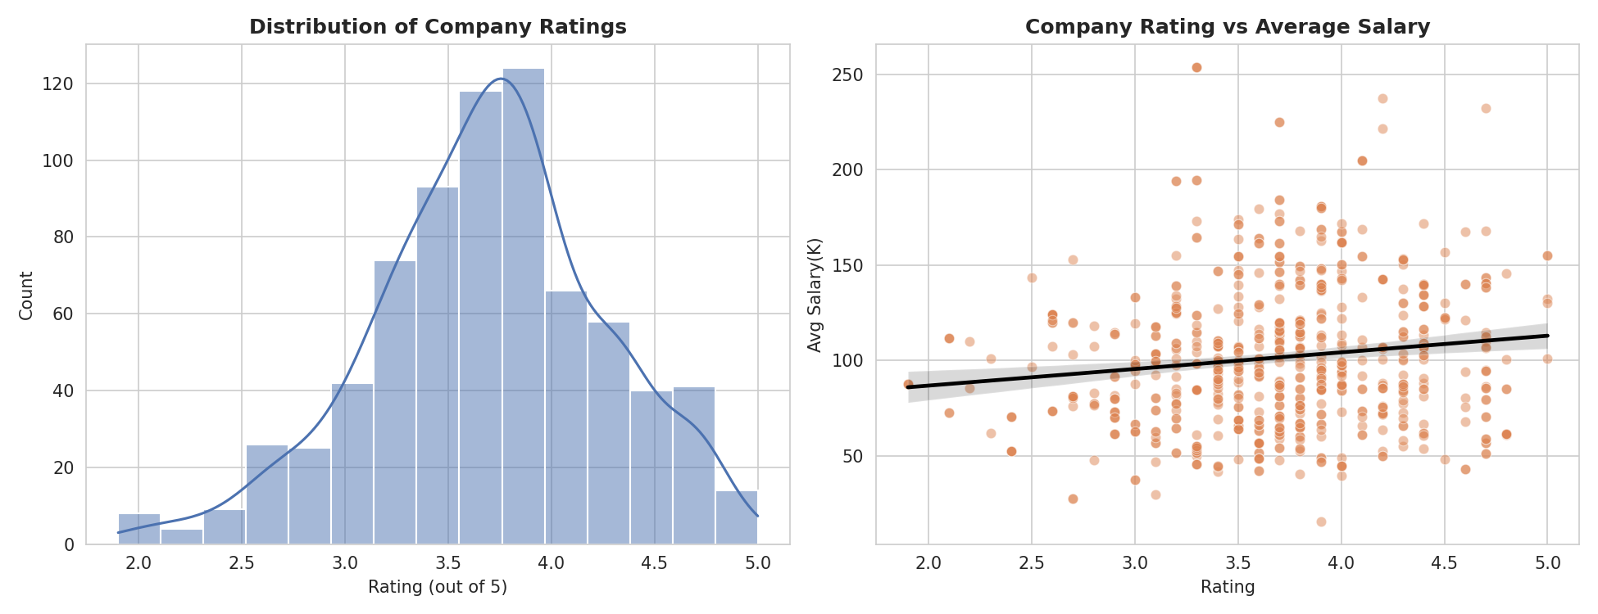
More Insights
Seniority moves salary; company rating & age barely do
Senior-flagged titles earn $121.7K vs. $93.1K for unflagged titles (+31%)
Rating → salary correlation: only r = 0.13 | Age → salary: r = 0.03
PRDA-04 | Job Market Analysis
12

Slide 13




Recommendations — For Job Seekers
Master the baseline
Specialize deliberately
Python, SQL and Excel appear in ~half of all postings regardless of title — build these first.
ML Engineer needs PyTorch/TensorFlow; Data Engineer needs Spark/AWS/Hadoop — the two are almost opposite skillsets.
Credentials carry weight
Go where the jobs are
A Master's or PhD correlates with a real 10-22% salary premium, concentrated in Data Scientist & research titles.
CA, MA, NY, VA & IL host ~60% of postings — geographic flexibility meaningfully expands opportunity.
PRDA-04 | Job Market Analysis
13

Slide 14


Recommendations — For Employers
Benchmark to market
Brand isn't a pay lever
Data Scientist offers below $90K-$146K (avg min-max) are likely to underperform, especially in CA, IL & D.C.
Rating and company age barely correlate with salary — smaller/newer firms can compete on scope & culture, not just cash.
Review the mid-size gap
Weight BI skills for Analysts
501-5,000 employee companies currently pay below both larger and smaller peers ($91K-$98K avg) — a likely friction point in hiring.
Excel & Tableau fluency matter as much as programming ability for Analyst hiring — a structurally different profile than Data Scientist/Engineer.
PRDA-04 | Job Market Analysis
14

Slide 15
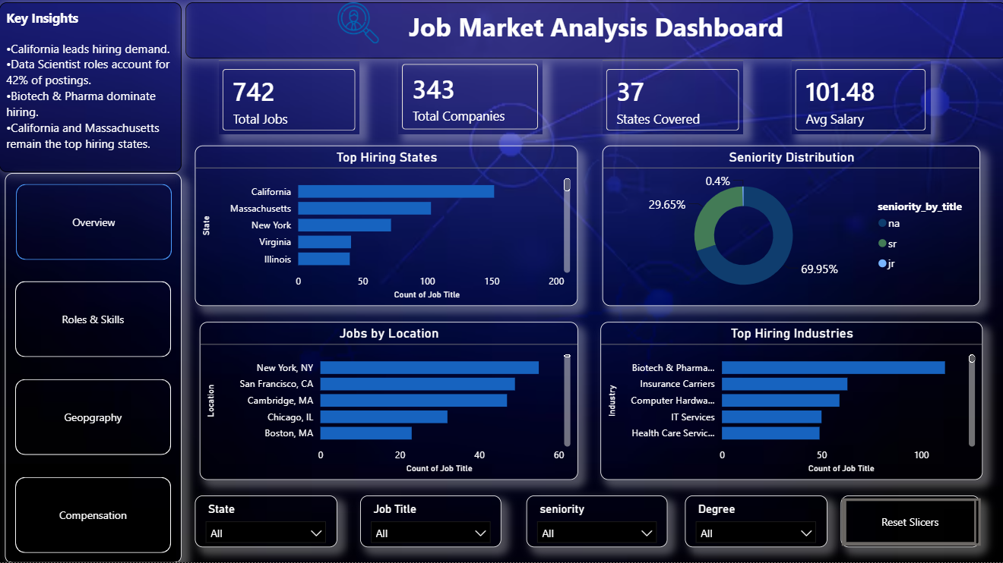
Interactive Dashboard — Overview
Headline KPIs, top hiring states, seniority split & top industries — synced slicers carry across every page
PRDA-04 | Job Market Analysis
15

Slide 16
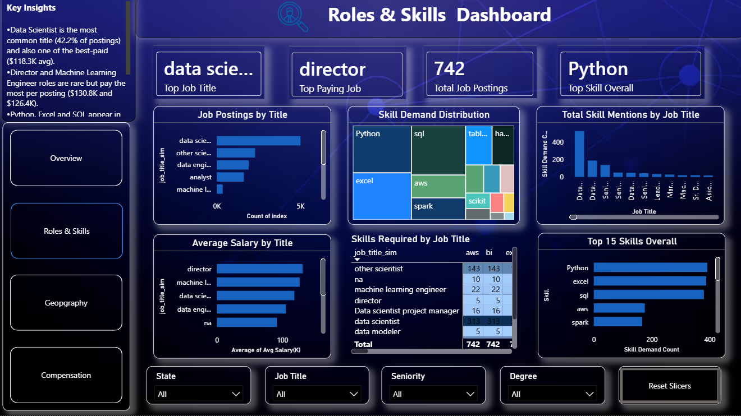
Interactive Dashboard — Roles & Skills
Job title volume & pay, skill-demand treemap, and the live skills-by-title matrix
PRDA-04 | Job Market Analysis
16

Slide 17
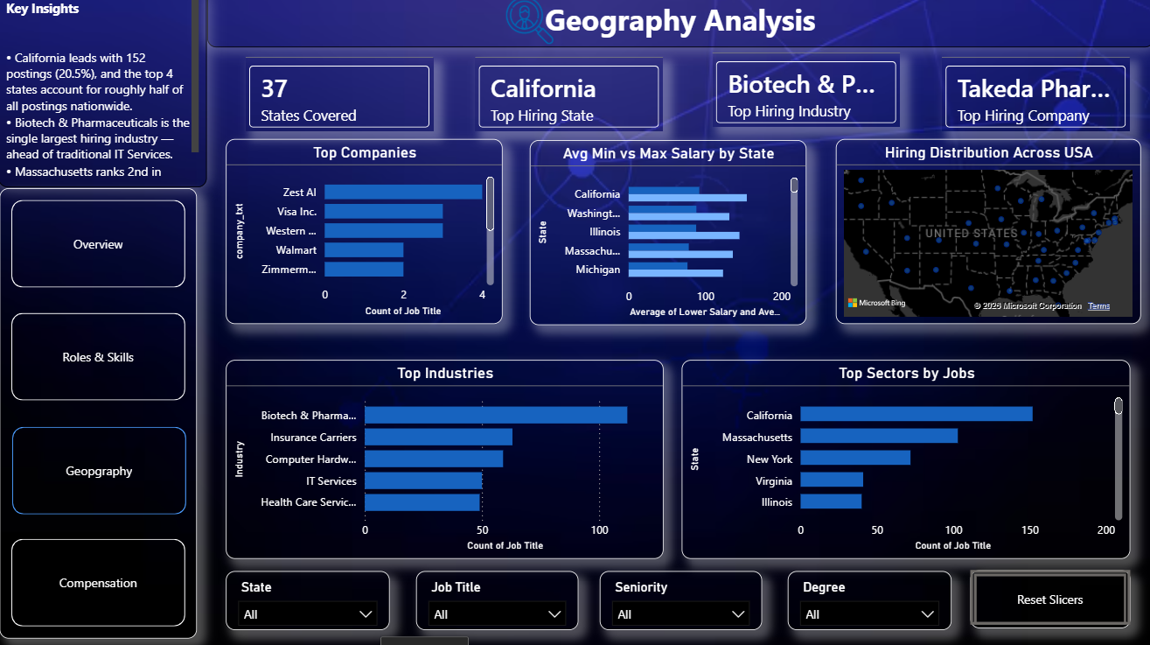
Interactive Dashboard — Geography
Top states, top companies, min/max salary by state, and hiring distribution across the U.S.
PRDA-04 | Job Market Analysis
17

Slide 18
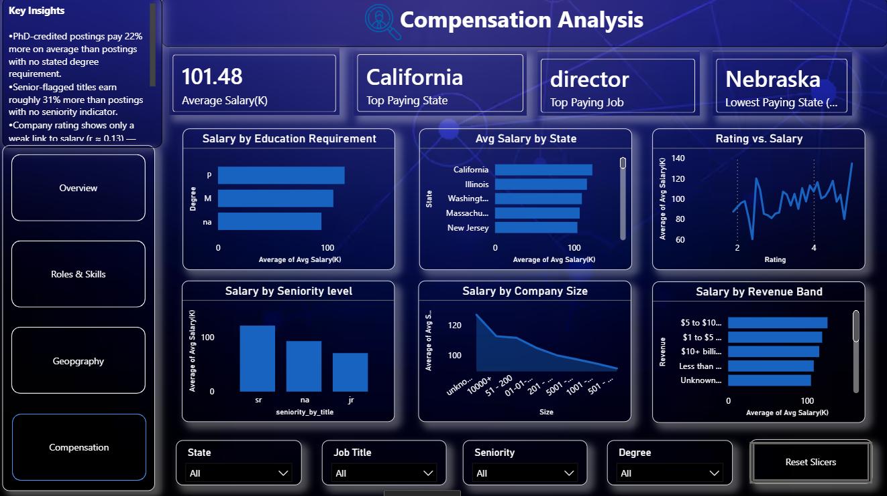
Interactive Dashboard — Compensation
Salary by education, seniority, company size & revenue, plus the rating-vs-salary relationship
PRDA-04 | Job Market Analysis
18

Slide 19
Conclusion
The U.S. data science job market is geographically concentrated (CA, MA, NY, VA, IL), industry-concentrated (Biotech & Insurance outweigh IT Services), and role-specific in its skill demands. Compensation is driven primarily by job title, industry, location and education — not by company rating or age. These findings give job seekers a prioritization framework and employers a benchmarking framework, both grounded directly in current market data.
Thank you
PRDA-04 — Job Market Analysis | Prepared by S Suhaiyla Sulthana

